Slide 1
Combating Deepfakes
Enhancing Deepfake Detection Through Diverse Data and Augmentation

Slide 2
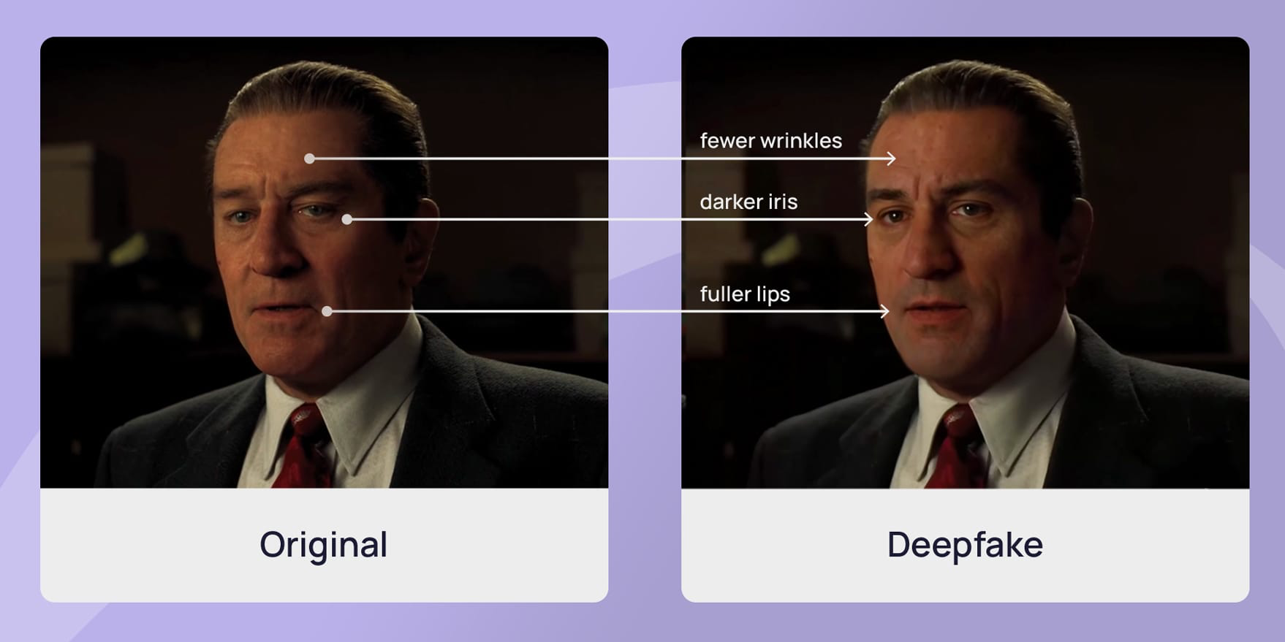
Deepfakes Definition
Deepfakes (a portmanteau of 'deep learning' and 'fake') are images, videos, or audio created or manipulated using AI tools to depict real or fictional people.
Source: Shamook (2020). De-aging Robert Deniro in The Irishman [Deepfake]
Notes:
2. Definition
What Are Deepfakes?
• “Deepfakes, a blend of ‘deep learning’ and ‘fake,’ refer to images, videos, or audio generated or manipulated using AI tools.”
• “They are used to depict real or fictional people in highly realistic forms.”
3. Visual Example
• Image Walkthrough:
• “Here, we see an example from The Irishman, where AI was used to de-age Robert De Niro.”
• Highlight key changes:
• “Fewer wrinkles on his face.”
• “Darker iris to mimic younger eyes.”
• “Fuller lips, reflecting a youthful appearance.”
4. Contextual Importance
• “This example demonstrates how deepfake technology can seamlessly alter visuals for purposes like film production, but it also hints at the ethical challenges tied to its misuse.”
5. Transition
• “Now that we’ve covered the definition and an example, let’s move on to the applications and implications of deepfakes in various fields.”

Slide 3
Significance of Deepfake Studies
Inevitable
Cuts film production costs and offers new entertainment experiences
Creates opportunities for virtual education
Widespread
Proliferating across sectors like entertainment, marketing, politics, and social media.
Used to create stunning films, manipulate public perception, and spread misinformation.
Profundity
Short-term risks include increased fraud, misinformation, and illegal content.
Erode media trust, leading to widespread skepticism.
Notes:
1. Introduction
• Transition from Previous Slide:
• “Now that we understand what deepfakes are, let’s explore their significance and impact.”
• “we can categorizes the importance of studying deepfakes into three areas: inevitability, widespread use, and profundity.”
2. Inevitable
• Key Points:
• “Deepfakes are transforming industries like entertainment and education.”
• “For example, they reduce production costs in films by eliminating the need for reshoots or expensive CGI.”
• “They also create new opportunities for virtual education, like lifelike historical recreations or personalized tutors.”
3. Widespread
• Key Points:
• “This technology has rapidly proliferated across diverse sectors, including entertainment, marketing, politics, and social media.”
• “While it has been used to produce stunning visuals in movies, it is also increasingly leveraged to manipulate public perception and spread misinformation.”
4. Profundity
• Key Points:
• “However, with great power comes significant risks.”
• “In the short term, deepfakes contribute to rising concerns about fraud, misinformation, and even illegal content creation.”
• “Over time, they erode trust in media, leading to a growing skepticism about the authenticity of any content.”
5. Conclusion and Transition
• Closing Statement:
• “Understanding the potential and pitfalls of deepfakes is essential as this technology continues to evolve.”

Slide 4
Limitations of Current Studies
Dataset Limitations
Overreliance on specific datasets that lack diversity (Passos et al. 2023)
Often focus on simpler deepfakes and may not adequately represent more complex forgeries.
Ethical and Legal Gaps
Significant gaps remain in addressing broader ethical and regulatory challenges.
Existing regulations fail to adequately protect against emerging threats posed by AI
Detection Model Vulnerabilities
Detection models struggle under challenging conditions, such as noise, visual occlusions.
Dependency on Specific Criteria.
Notes:
After looking at the previous research, although there are many algorithms to combat deepfake content, like natural network, convolutional neural network.
Most of the datasets focus on specific language, races, region, like English,
Ethical and Legal Gaps, existing regulations fail to protect against emerging threats posed by AI

Slide 5
Project Objectives
To improve deepfake detection models by addressing the limitations of current datasets and incorporating ethical considerations into the development and deployment process.

Slide 6
Relevant Theories Framework
Ethical Frameworks for Responsible Detection
Consequentialism
Focuses on evaluating outcomes (e.g., reducing misinformation vs. risks like privacy violations).
Non-Consequentialism
Prioritizes intentions behind technology use, emphasizing transparency and individual rights.
Agent-Centered Approaches
Assigns responsibility to those deploying technologies, ensuring ethical oversight, particularly in sensitive areas like politics or personal media.
Notes:
As we move forward in the development of deepfake detection technologies, it is essential to not only focus on their technical capabilities but also consider the ethical implications.
To guide our work, we draw on three key ethical frameworks from the course:
Consequentialism, which evaluates the outcomes of using detection technologies, specifically focusing on reducing misinformation and mitigating potential privacy violations.
Non-Consequentialism prioritizes the intentions behind these technologies, ensuring transparency and the protection of individual rights.
Lastly, Agent-Centered Approaches assigns responsibility to those deploying these tools, emphasizing ethical oversight in sensitive areas like politics or personal media.
By integrating these frameworks, we aim to design detection tools that are both effective and ethically responsible

Slide 7
Solution
Improving Deepfake Detection with Diverse Data
Data Augmentation: Apply techniques like rotating, blurring, pitch shifting, and noise addition to improve model adaptability across varied input conditions.
Global Content Inclusion: Collect data from social platforms worldwide to expose models to diverse accents, styles, and scenarios for improved generalization.
Multi-Modal Training: Combine image and audio data to build comprehensive and reliable detection systems for real-world applications.

Slide 8
Solution
Ethical and Legal Considerations
Regulatory Alignment: Align with privacy regulations like GDPR to safeguard user privacy and prevent misuse.
Transparency & Accountability: Promote clear accountability for false positives and detection errors, especially on media platforms.
Privacy Protection: Prioritize individual privacy and minimize risks to personal reputation, particularly in sensitive areas like politics and personal media.
Notes:
While the primary focus of deepfake detection is on technical solutions, ethical and legal considerations are equally important to ensure responsible use. Future research should align with regulations like GDPR, which is a privacy law designed to protect personal data and give individuals control over how their data is used. Ensuring compliance with GDPR helps safeguard user privacy and prevent misuse. It’s also essential to emphasize transparency and accountability on media platforms, where detection errors can have serious consequences. Additionally, detection models must prioritize privacy protection and minimize false positives to avoid potential harm to personal reputations, especially in sensitive areas like politics or personal media.

Slide 9
Type of Study: Mixed Methods
Quantitative: Evaluating the performance of detection models before and after incorporating the extended dataset.
Qualitative: Collecting stakeholder insights on the ethical and technological aspects of addressing deepfake challenges through a survey.

Slide 10
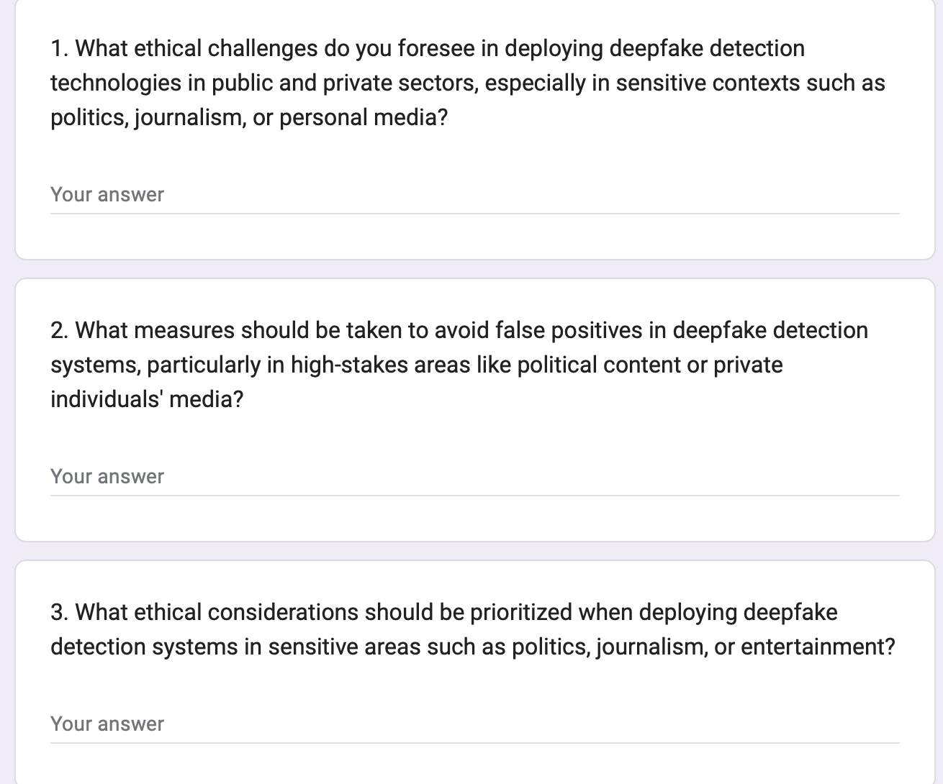
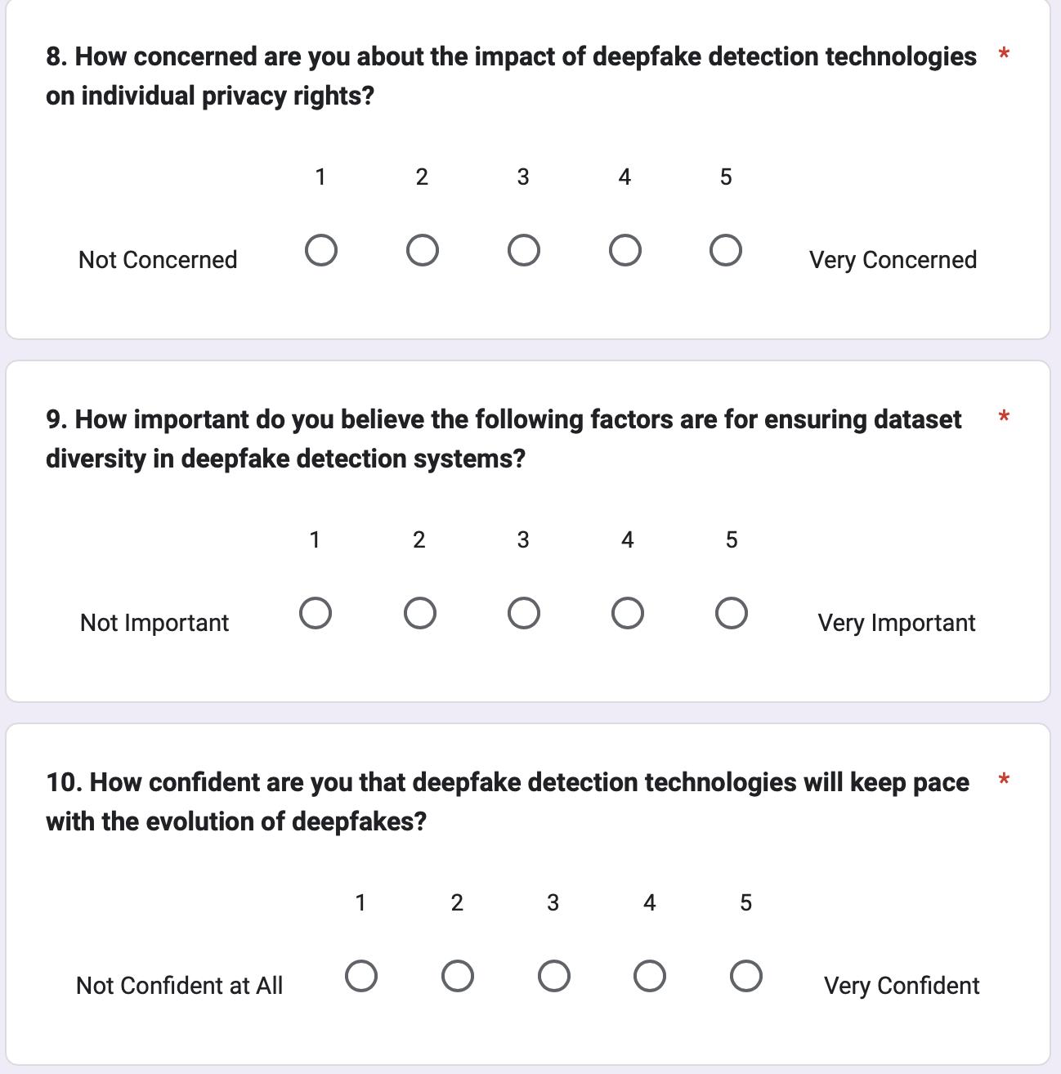
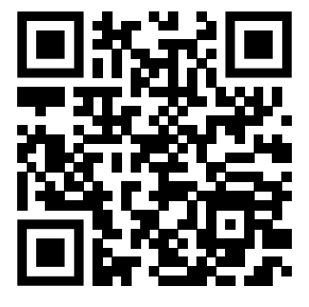
Qualitative Methods
Open-Ended Questions
Design 7 open-ended questions
Likert-Scale Questions
Design 5 likert-scale questions

Slide 11
Process
Data Collection
Data
Augmentation
Model Training
Evaluation
Combine baseline dataset, DFDC, and data collected through APIs from social media platforms.
Data augmentation creates diverse variations of data to enhance model training.
Using the pre-trained model on the dataset.
measures model performance using metrics like accuracy, recall, F1, and AUC-ROC.

Slide 12
Limitations of the Proposed Solutions
Real-World Effectiveness
Full performance can only be accurately evaluated through real-world deployment.
Dependent on user interaction and behavior, which are unpredictable.
API Reliance
Dependent on third-party APIs for data collection, which may face access restrictions.
Risks include data quality issues, limited access, and changes in platform policies over time.
Risk of Overfitting
Potential for models to overfit to specific training datasets.
Notes:
While our proposed solutions show potential, they come with certain limitations
First, real-world effectiveness can only be assessed through deployment in live environments, which involve unpredictable factors like user behavior.
Second, we encounter API reliance. Since our data collection process depends on third-party APIs, we're exposed to risks such as limited data access, inconsistent data quality, and changes in platform policies that could hinder the stability of our solutions.
, the risk of overfitting persists. Despite our efforts with data augmentation and expand the dataset diversity, there is always the risk that models still overfit to specific training patterns, limiting their generalizability.
Addressing these challenges will require continuous model updates and robust testing across varied scenarios.

Slide 13
Conclusion
Diverse Datasets
Expanding datasets across languages, cultures, and scenarios improves model generalization and accuracy in real-world conditions.
Data Augmentation
Techniques like rotating, blurring, and adding noise to images help detection models recognize deepfakes in diverse environments.
Mixed-Methods Approach
Combining quantitative data (augmented datasets) with qualitative feedback (legal & ethical perspectives) ensures robust and responsible detection systems.
Notes:
In conclusion, Our focus on diverse datasets is essential. By expanding datasets to include a wide range of languages, cultures, and scenarios, we enhance the model's ability to generalize and perform accurately in real-world conditions.
Additionally, our application of data augmentation techniques—such as rotating, blurring, and adding noise—helps our detection models adapt to diverse and challenging environments.
Finally, our mixed-methods approach, combining quantitative analysis through augmented datasets and qualitative feedback on ethical and legal considerations, ensures that our detection systems are both robust and responsible.
Together, these elements pave the way for more reliable and effective deepfake detection, addressing both technical and ethical challenges head-on.
Conclusion: Deepfake Detection with Diverse Data and Augmentation
The sources emphasize the importance of using diverse data and data augmentation to improve deepfake detection models. They highlight that this approach can address current limitations in deepfake detection, such as the overreliance on specific datasets that lack diversity in languages, cultures, and scenarios.
Diverse datasets can enhance the generalizability of detection methods and make them more effective in real-world settings.
Data augmentation techniques, like rotating, blurring, and adding noise to images, can help models recognize deepfakes under various conditions.
By incorporating data from various sources, including social media platforms and synthetic data generated by GANs, models can be exposed to a broader range of content, accents, and visual styles.
This can improve detection accuracy across different languages, cultures, and complex scenarios.
The sources also stress the importance of ethical and legal considerations in developing and deploying deepfake detection tools.
Future research should align with regulations like GDPR to protect user privacy and address the misuse of deepfakes.
Transparency and accountability in media platforms should be emphasized.
Detection models should prioritize individual privacy and minimize false positives to prevent potential harm to personal reputations.
The research proposes a mixed-methods approach, combining quantitative and qualitative data to evaluate the effectiveness of augmented deepfake detection models.
Quantitative data will include augmented deepfake datasets across various languages and scenarios.
Qualitative data will come from expert feedback on the legal and ethical implications of deploying these systems.
By adopting a multi-faceted approach that considers technical advancements, ethical frameworks, and legal regulations, we can develop more robust, reliable, and responsible deepfake detection systems. This will help mitigate the risks associated with deepfakes and harness their potential benefits for society

Slide 14
Take Home Message
Diverse data and ethical design are key to building robust, future-proof deepfake detection systems.

Slide 15
Reference
[1] Salman, S., Shamsi, J. A., & Qureshi, R. (2023). Deep fake generation and detection: Issues, challenges, and solutions. *IT Professional, 25*(1), 52-59. https://doi.org/10.1109/MITP.2022.3230353
[2] Meskys, E., Liaudanskas, A., Kalpokiene, J., & Jurcys, P. (2020). Regulating deep fakes: Legal and ethical considerations. *Journal of Intellectual Property Law & Practice, 15,* 24-31. https://doi.org/10.1093/jiplp/jpz167
[3] van der Sloot, B., & Wagensveld, Y. (2022). Deepfakes: Regulatory challenges for the synthetic society. *Computer Law & Security Review, 46,* 105716. https://doi.org/10.1016/j.clsr.2022.105716
[4] Li, M., & Wan, Y. (2023). Norms or fun? The influence of ethical concerns and perceived enjoyment on the regulation of deepfake information. *Internet Research, 33*(5), 1750-1773
[5] Wang, R., Juefei-Xu, F., Huang, Y., Guo, Q., Xie, X., Ma, L., & Liu, Y. (2020). DeepSonar: Towards effective and robust detection of AI-synthesized fake voices. In *Proceedings of the 28th ACM International Conference on Multimedia (MM '20)* (pp. 1207-1216). Association for Computing Machinery. https://doi.org/10.1145/3394171.3413716
[6] Wang, Y., & Huang, H. (2024). Audio–visual deepfake detection using articulatory representation learning. *Computer Vision and Image Understanding, 248,* 104133. https://doi.org/10.1016/j.cviu.2024.104133
[7] Mustak, M., Salminen, J., Mäntymäki, M., Rahman, A., & Dwivedi, Y. K. (2023). Deepfakes: Deceptions, mitigations, and opportunities. *Journal of Business Research, 154,* 113368. https://doi.org/10.1016/j.jbusres.2022.113368
[8] Rana, M. S., Nobi, M. N., Murali, B., & Sung, A. H. (2022). Deepfake detection: A systematic literature review. *IEEE Access, 10,* 25494-25513. https://doi.org/10.1109/ACCESS.2022.3154404
[9] Passos, L. A., Jodas, D., Costa, K. A. P., Souza Júnior, L. A., Rodrigues, D., Del Ser, J., Camacho, D., & Papa, J. P. (2024). A review of deep learning-based approaches for deepfake content detection. *Expert Systems, 41*(8), e13570. https://doi.org/10.1111/exsy.13570
[10] Booz Allen. (n.d.). Deepfakes pose business risks—Here’s what to know. Retrieved from https://www.boozallen.com/insights/ai-research/deepfakes-pose-businesses-risks-heres-what-to-know.html
[11] U.S. Government Accountability Office (GAO). (2024, March 11). *Science & Tech Spotlight: Combating deepfakes*. https://www.gao.gov/products/gao-24-107292
[12] RecordedFuture. (n.d.). *2024 deepfakes and election disinformation report: Key findings & mitigation strategies*. Retrieved from https://www.recordedfuture.com/research/targets-objectives-emerging-tactics-political-deepfakes

